Slide 1
Let’s invest in employee training to improve the in-store customer experience
Notes:
7.8k

Slide 2
Back-to-school shopping accounts for
30%
of our annual revenue. Because of this, it is a
huge driver of our overall annual success.
Data source: monthly Sales report. Based on prior three years (2017, 2018, 2019) of annual back-to-school sales compared to total annual sales.
Notes:
7.8l

Slide 3
What we’ll cover today
12
Discuss what we’ve learned
from our survey analysis and
Suggest specific recommendations
on changes to make for the upcoming back-to-school shopping season to improve customer satisfaction and increase sales.
Notes:
7.8m

Slide 4
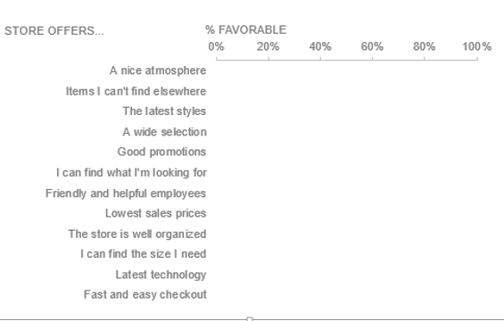
Back-to-school shopping: consumer sentiment
Notes:
7.8m

Slide 5
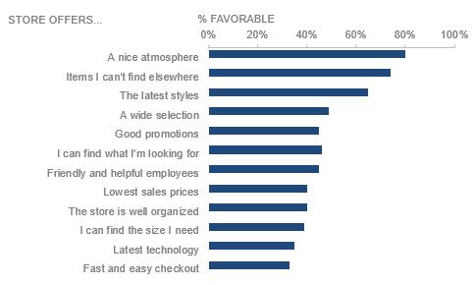
Back-to-school shopping: consumer sentiment
Notes:
7.8m

Slide 6
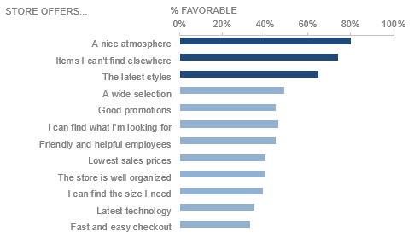
Back-to-school shopping: consumer sentiment
Notes:
7.8m

Slide 7
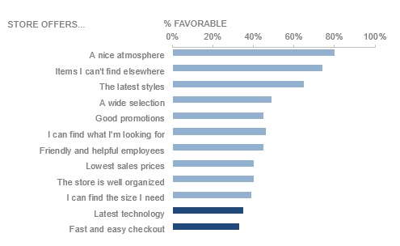
Back-to-school shopping: consumer sentiment
Notes:
7.8m

Slide 8
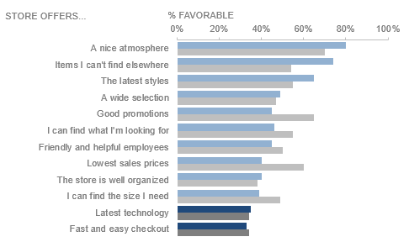
Back-to-school shopping: consumer sentiment
Notes:
7.8m

Slide 9
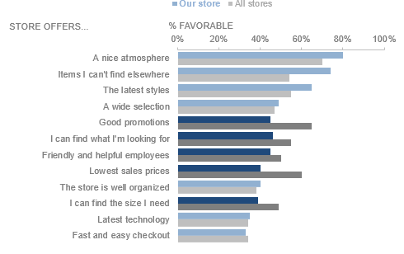
Back-to-school shopping: consumer sentiment
Notes:
7.8m

Slide 10
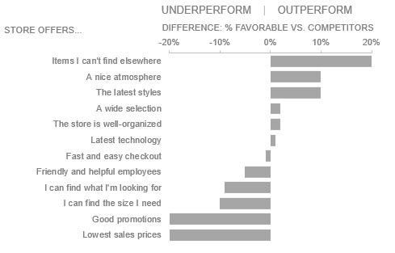
Back-to-school shopping: consumer sentiment
Notes:
7.8m

Slide 11
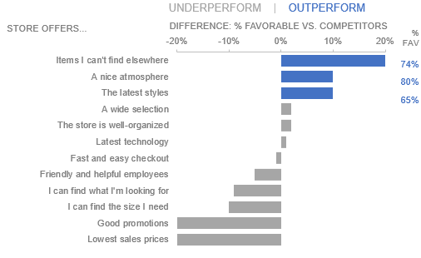
Back-to-school shopping: consumer sentiment
Notes:
7.8m

Slide 12
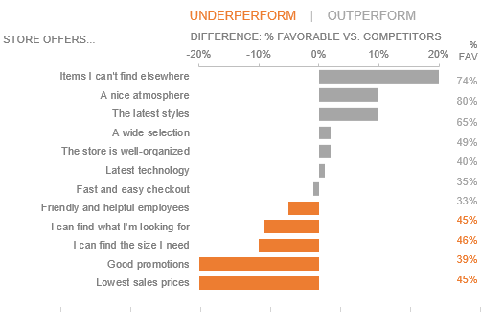
Back-to-school shopping: consumer sentiment
Notes:
7.8m

Slide 13
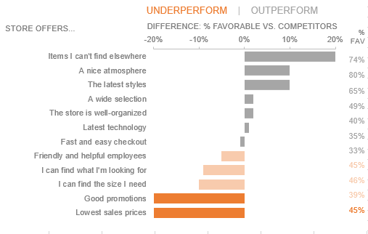
Back-to-school shopping: consumer sentiment
Notes:
7.8m

Slide 14
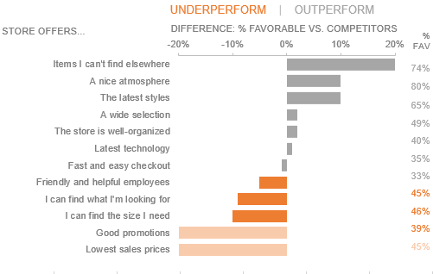
Back-to-school shopping: consumer sentiment
Notes:
7.8m

Slide 15
Let’s invest in employee training to improve the in-store customer experience
Notes:
7.8k

Slide 16
Action needed: invest in employee training
Back-to-school shopping: consumer sentiment
UNDERPERFORM | OUTPERFORM
THE GOOD NEWS:
We’re beating the competition when it comes to the latest styles that people can’t find elsewhere and store atmosphere.
WE CAN IMPROVE:
We score low and lower than the competition in areas related to helpful employees and customers being able to find what they are looking for. We also score lower than the competition on promotions/sales, but don’t recommend focusing here.
RECOMMENDATION: Invest in employee training to improve customer experience.
STORE OFFERS…
Data Source: 2019 Back-to-School shopping survey (represents 21,862 survey responses).
Notes:
7.8z

